Slide 1
Drafting for Dollars: Investigating ROI of NFL Draft Picks on Team Performance
Ashton Mehta, Bo Han, Govind Rachapudi, Viren Halaharivi

Slide 2
Investigating the NFL Draft
Our Question:
How well can we predict a player’s value based on their pre-draft performance metrics?
Our Motivation:
The primary objective of the NFL draft is to pick players that can positively impact the team in the present and years into the future.
Player value can depend on physical gifts, college performance, or plain generational talent.

Slide 3
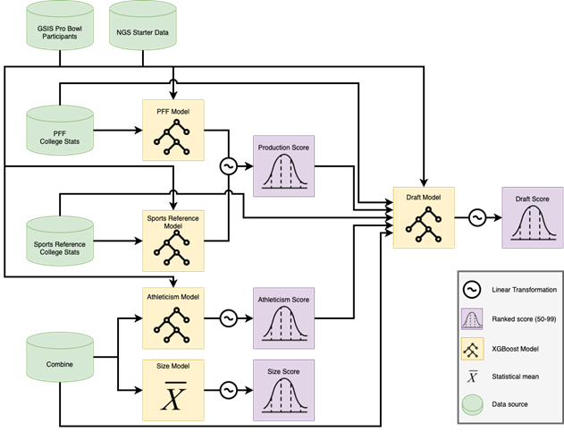
Existing Approaches
Next Gen Stats (AWS) Draft Model: predicts chances of success in NFL
Separated by position
NFL Combine results since 2003, college results since 2005
XGBoost
Probability of becoming a starter or making Pro Bowl in first 3 NFL seasons
Notes:
Ashton

Slide 4
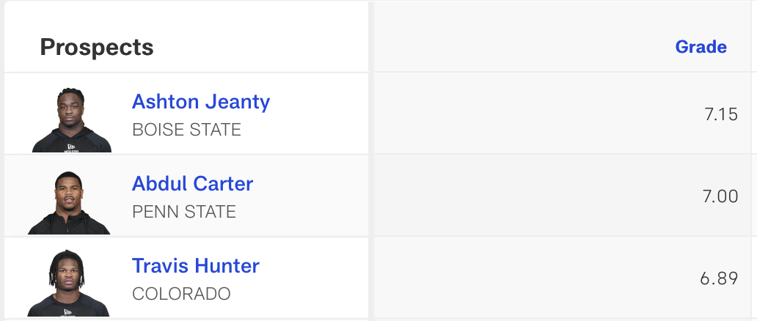
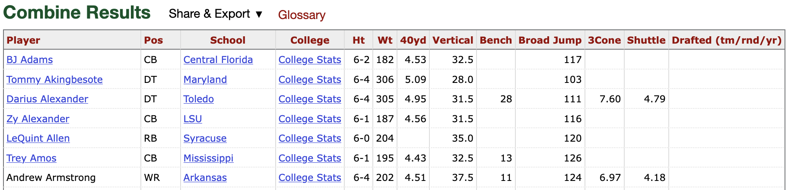
Data Collection and Methods
Prospect grade (scouting) data from NFL.com
NFL combine data from pro-football-reference.com
College compiled stats from sports-reference.com
Investigate first two rounds of the Draft from 2014-2024 as NFL prospect grades began to be recorded at this time
We scoped in on offensive skill positions due to time (QB, RB, WR, and TE).
Notes:
Ashton

Slide 5
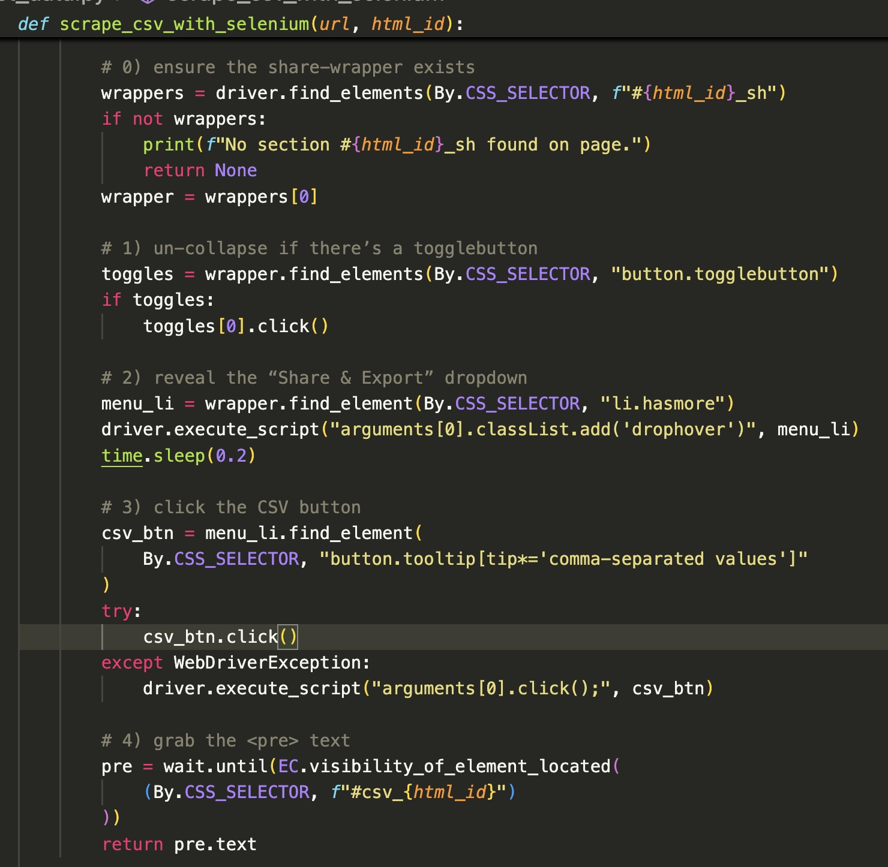
Web Scraping Task
No existing API or table for college data
BUT standard URL format and HTML structure
Solution: Web Scraping with Selenium
URL: http://www.sports-reference.com/cfb/players/jameis-winston-1.html
Challenge: Depending on speed of ads loading, HTML structure could vary
Pivoted approach from bulk scraping to individual player scraping
Notes:
Ashton

Slide 6
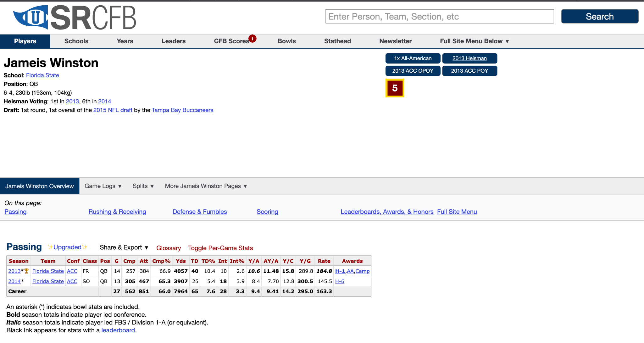
Notes:
Ashton

Slide 7
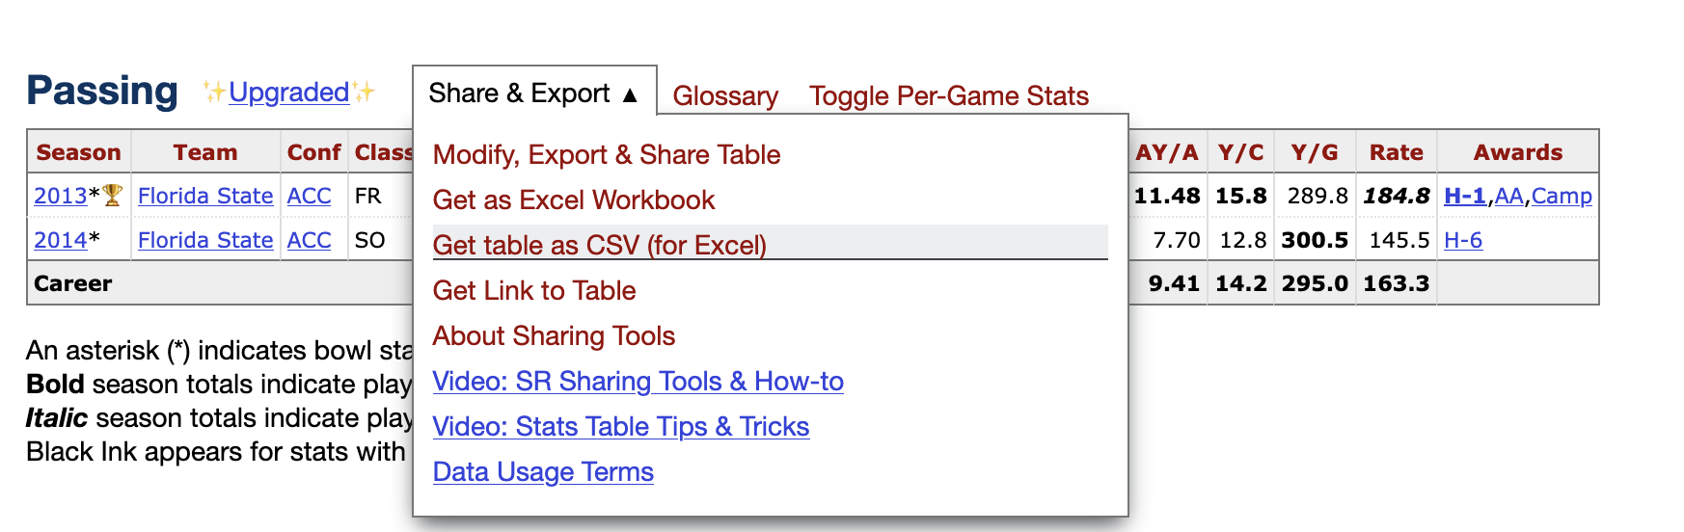
Notes:
Ashton

Slide 8
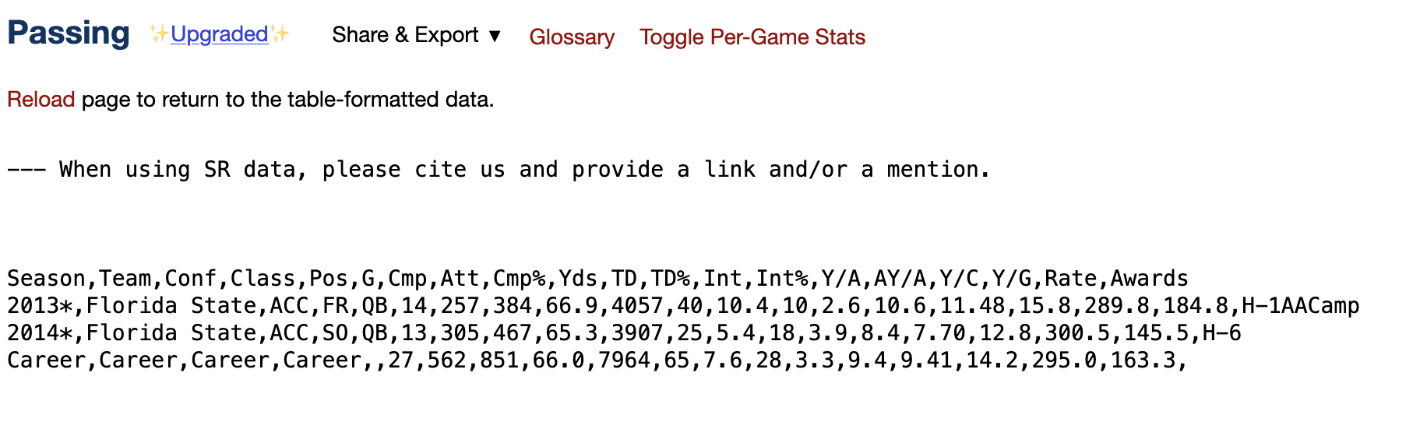
Notes:
Ashton

Slide 9
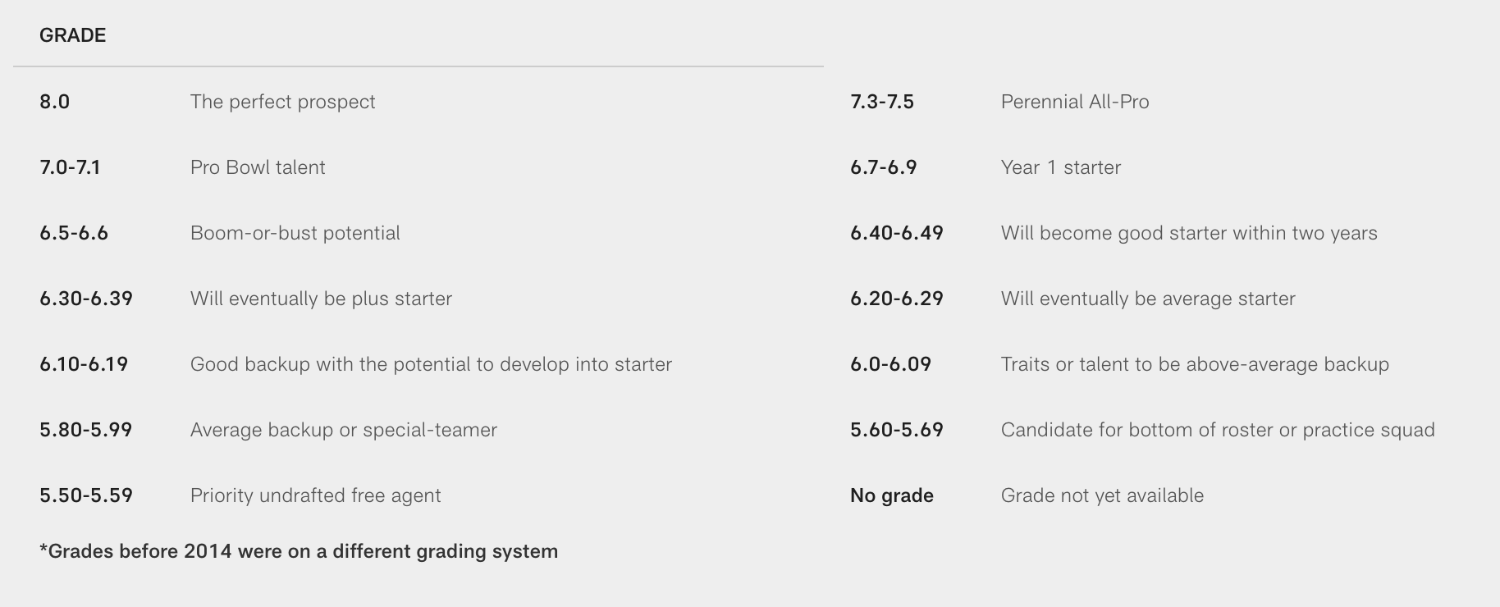
Feature Selection
NFL Combine Data
Height
Weight
40 yd
Vertical
Bench
College Performance Data
Career totals split by position
WR, TE -> Receiving vs. QB -> Passing
NFL Prospect Data
Scouting grade (5.60 - 8)
“Practice Squad” vs. “Perfect Candidate”

Slide 10
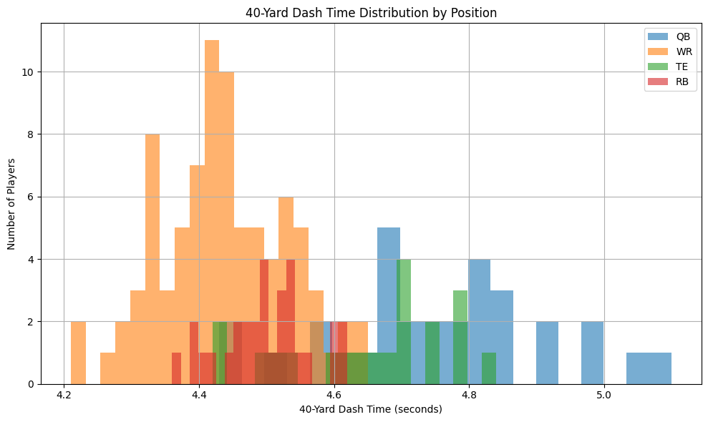
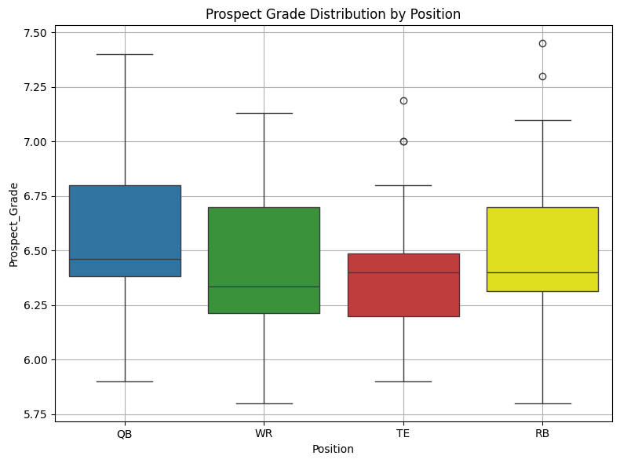
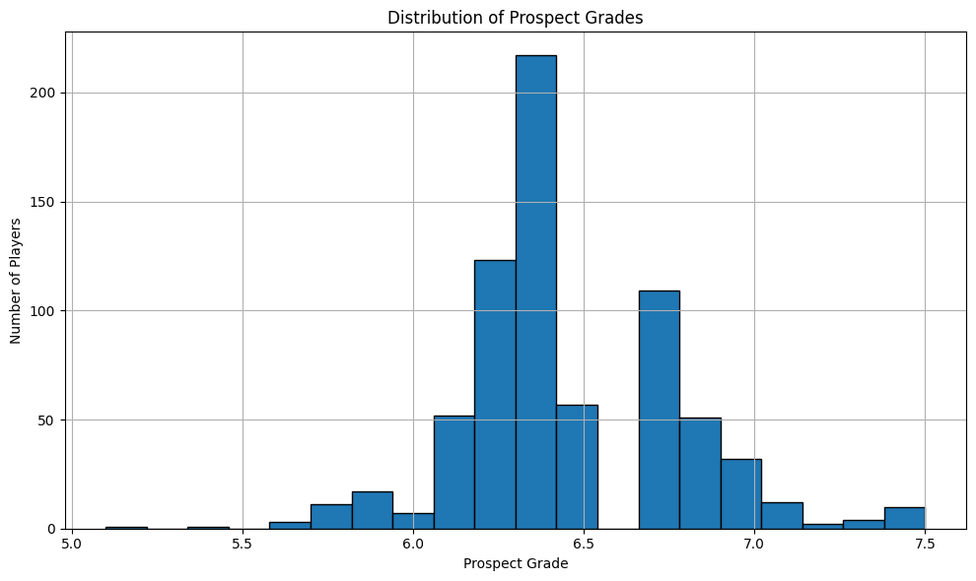
Data Exploration
WRs dominate the fastest 40 yard times and cluster around 4.3-4.5 seconds
QBs show wider and slower distributions typically above 4.7 seconds
RBs and TEs fall in between, with RBs skewing faster than TEs
QBs have the highest median and widest spread in prospect grades, indicating varied evaluations
TEs have the lowest median and tighter distribution, with several outliers above 7.0
WRs and RBs have similar medians around 6.4
Distribution appears to have a normal shape
Unimodal with a peak grade of 6.4

Slide 11
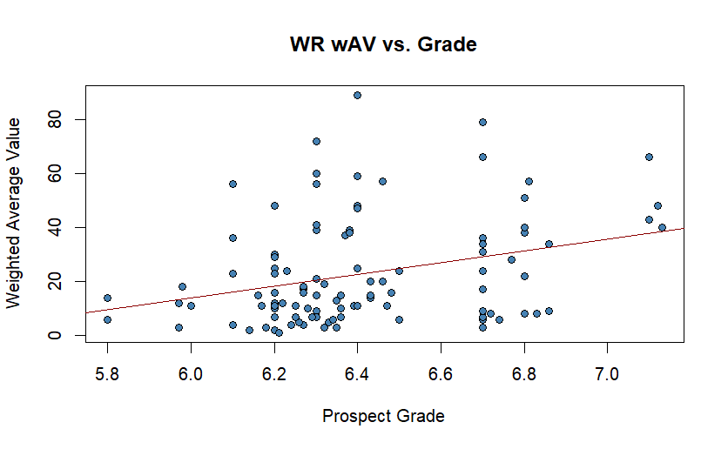
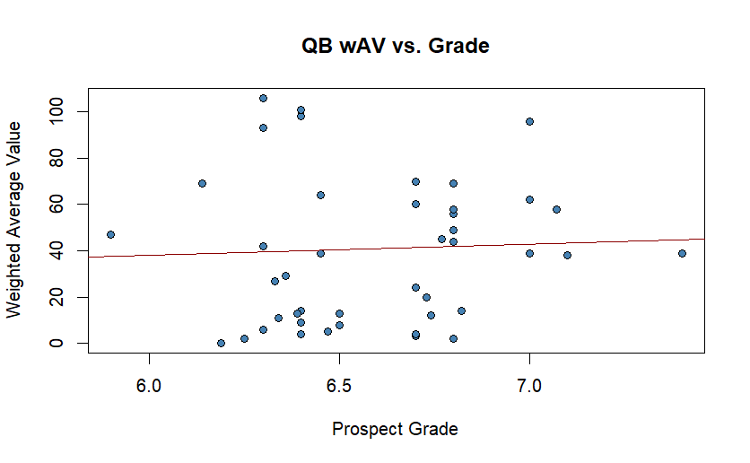
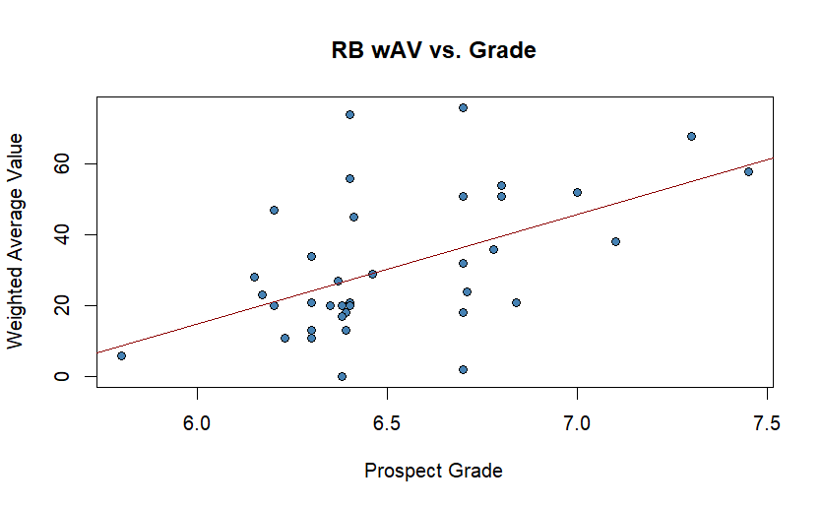
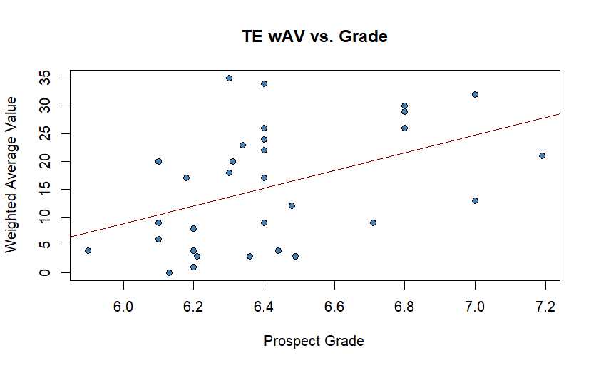
Modeling
Correlation: 0.04207657
Coefficients
2.5 % 97.5 %
(Intercept) -210.64552 231.00996
Prospect_Grade -28.88746 38.18434
Four Methods:
Using Prospect Grades
The Eye Test
Combine Results
College Performance
Correlation: 0.3021216
Coefficients
2.5 % 97.5 %
(Intercept) -200.298374 -30.51375
Prospect_Grade 8.337071 34.80960
Correlation: 0.5213035
Coefficients
2.5 % 97.5 %
(Intercept) -283.03250 -59.15888
Prospect_Grade 13.84262 48.13879
Correlation: 0.4483107
Coefficients
2.5 % 97.5 %
(Intercept) -164.027579 -9.163227
Prospect_Grade 3.861747 27.955551

Slide 12
Modeling
QBs Correlation
wAV
wAV 1.00000000
Ht_inch -0.07053628
Wt 0.01388233
QBs Coefficients
2.5 % 97.5 %
(Intercept) -253.8068077 578.297081
Ht_inch -9.9534819 4.748394
Wt -0.8818825 1.549615
Four Methods:
Using Prospect Grades
The Eye Test
Combine Results
College Performance
RBs Correlation
wAV
wAV 1.0000000
Ht_inch 0.3657417
Wt 0.2576134
RBs Coefficients
2.5 % 97.5 %
(Intercept) -585.3635716 28.1910371
Ht_inch -1.2529985 9.5491664
Wt -0.6687084 0.8108294
WRs Correlation
wAV
wAV 1.0000000
Ht_inch 0.1294108
Wt 0.2404916
WRs Coefficients
2.5 % 97.5 %
(Intercept) -134.73269863 156.2722415
Ht_inch -3.44495922 1.7195364
Wt 0.02939661 0.7142921
TEs Correlation
wAV
wAV 1.0000000
Ht_inch -0.2512285
Wt -0.4307296
TEs Coefficients
2.5 % 97.5 %
(Intercept) -297.734832 423.831293719
Ht_inch -4.571364 7.162238696
Wt -1.161648 -0.005744843

Slide 13
Modeling
Four Methods:
Using Prospect Grades
The Eye Test
Combine Results
College Performance
WRs Correlation
wAV
wAV 1.000000000
X40yd 0.220583280
Vertical -0.049760095
Bench -0.004105177
Broad.Jump -0.185324474
X3Cone -0.017251762
Shuttle -0.162506017
QBs Correlation
wAV
wAV 1.00000000
X40yd -0.18699488
Vertical -0.18487976
Broad.Jump 0.13515182
X3Cone -0.27242496
Shuttle -0.08501118
QBs Coefficients
2.5 % 97.5 %
(Intercept) -1554.140760 1473.144057
X40yd -167.050171 137.500985
Vertical -17.676249 2.736667
Broad.Jump -2.827353 10.043808
X3Cone -189.461181 176.374250
Shuttle -138.717180 149.938103
WRs Coefficients
2.5 % 97.5 %
(Intercept) -712.945740 440.498218
X40yd -40.603425 180.578108
Vertical -3.648702 5.483500
Bench -2.255223 2.734884
Broad.Jump -2.933233 1.065541
X3Cone -43.368257 76.553822
Shuttle -112.929579 27.764456
RBs Correlation
wAV
wAV 1.00000000
X40yd -0.31590019
Vertical -0.12591185
Bench -0.51297634
Broad.Jump 0.03855318
X3Cone 0.14450343
Shuttle 0.62706026
TEs Correlation
wAV
wAV 1.0000000
X40yd -0.7171129
Vertical 0.7030644
Bench -0.6521035
Broad.Jump 0.7717722
X3Cone -0.7425957
Shuttle -0.6431500
RBs Coefficients
2.5 % 97.5 %
(Intercept) -2155.3764424 40.8485306
X40yd -164.2847684 280.9648508
Vertical -6.9753457 5.6032903
Bench -5.9336462 -0.4897852
Broad.Jump 0.2361109 6.9216519
X3Cone -87.8197235 78.3734834
Shuttle 26.6611368 219.6177458
TEs Coefficients
2.5 % 97.5 %
(Intercept) -321.077192 435.546015
X40yd -86.385913 26.930588
Vertical -1.066858 3.120621
Bench -2.794918 0.536656
Broad.Jump -1.083053 2.228572
X3Cone -36.811307 53.323416
Shuttle -84.055899 64.050629

Slide 14
Modeling
Four Methods:
Using Prospect Grades
The Eye Test
Combine Results
College Performance
QBs Correlation
wAV
wAV 1.0000000000
G_college -0.0004450872
Cmp. -0.3263091534
Yds 0.0449071434
TD. 0.0562611255
Int. 0.2679070892
Rate -0.0970800367
WRs Correlation
wAV
wAV 1.000000000
G_college -0.134232664
Y.R -0.008650581
TD 0.144762112
Y.G 0.332294915
QBS Coefficients
2.5 % 97.5 %
(Intercept) -81.30102832 4.045986e+02
G_college -1.64536496 1.730138e+00
Cmp. -9.80562614 2.448814e+00
Yds -0.00249161 9.191223e-03
TD. -10.12422648 3.316641e+01
Int. -7.34197444 3.697895e+01
Rate -3.24390711 2.899035e+00
WRs Coefficients
2.5 % 97.5 %
(Intercept) -50.28567673 42.8728671
G_college -0.71488646 0.5876090
Y.R -1.52852450 2.1608491
TD -0.75041400 0.7056841
Y.G 0.05409109 0.6914710
RBs Correlation
wAV
wAV 1.00000000
G_college -0.02203074
Y.A 0.29808645
Y.R 0.44765363
TD 0.08304180
Y.G 0.29505384
TEs Correlation
wAV
wAV 1.00000000
G_college -0.09609525
Y.R 0.28262021
TD 0.06618878
Y.G 0.34510191
RBs Coefficients
2.5 % 97.5 %
(Intercept) -137.69902150 -1.4907201
G_college -0.56333412 1.5532692
Y.A -4.78705122 15.6819468
Y.R 0.52318205 6.2084243
TD -1.43384049 0.2772517
Y.G -0.01381816 0.7761912
TEs Coefficients
2.5 % 97.5 %
(Intercept) -66.31026131 37.8824446
G_college -0.48676320 0.7408886
Y.R -1.49619931 4.0657696
TD -1.23910961 0.5214242
Y.G -0.06063402 0.6714706

Slide 15
Results and Interpretation
Key Takeaways:
Prospect Grades correlate strongly with the RB (.52) and TE (.45) values, while QBs (.04) and WRs (.30) show weaker relationships.
The Eye Test (Height/Weight) is not enough to indict the potential value of a player at the WR and RB due to its minimal correlation.
Combine Results such as Shuttle Time for RBs (.63) and X3Cone for TEs were useful, while other combine results such as Bench Press and Broad Jump showed lower correlation.
College statistics such as Yards per Reception (WRs) and Yards per Attempts (RBs) showed moderate correlation and predictive power for ROI. However, no single stat consistently predicted pro-football success.

